Slide 1
The Right Fit –Matching Donors with Charitable Giving Strategies
Cindy M. Campbell, J.D., LL.M. in Taxation, CPWA®
Senior Vice President | Senior Wealth Strategist
Regions Private Wealth Management
510 Central Avenue
St. Petersburg, FL 33701
Phone: (727) 822-0901
Email: CINDY.CAMPBELL@regions.com

Slide 2






Our Customized Wealth Team
Our promise is to make a difference in the lives of our clients and their families, today and for a lifetime. To do that, our commitment is to build the right team around the client and deliver solutions that address their specific needs and priorities.
Trust
Advisor
Clients & Families
Lending Advisor
Trust & Estate Administration
Customized Lending Solutions
Financial Advisor
Wealth Strategist
Wealth Assessment and Planning
Brokerage Services*
Natural Resources & Real Estate
NRRE
Manager
Wealth Advisor
Portfolio Manager
Investment Management & Protection
Relationship Specialist Support
*Regions Investment Solutions is a marketing name of Cetera Investment Services. Securities and insurance products are offered through Cetera Investment Services LLC, member FINRA/SIPC. Advisory services are offered through Cetera Investment Advisers LLC. Neither Cetera Investment Services nor Cetera Investment Advisers is an affiliate of Regions Bank or its related companies.

Slide 3
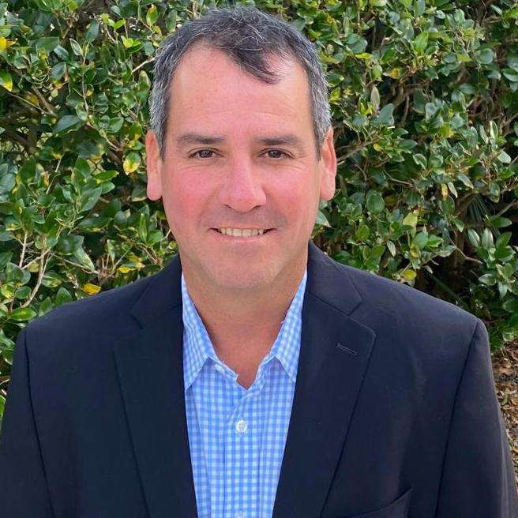
Your Wealth Management Team
Eduardo Andrade is a Vice President and a Wealth Advisor with Regions Private Wealth on the Jacksonville team. Eduardo is the main point of contact for the Private Wealth team that delivers a full range of financial products and services to clients, so that those clients can achieve specific financial goals. This includes financial planning, portfolio management, and other aggregated financial services for individuals. Eduardo and his team achieve short, medium and long-term financial goals.
Eduardo Andrade
Wealth Advisor
(904) 998-4971 office
(786) 200-2592 mobile eduardo.andrade@regions.com
Eduardo has a 20 year career in Banking working with both domestic and international Banks. He was previously an Executive Director with Julies Baer based in Panama and a VP in other large institutions such as JP Morgan, Bank of America and BNP Paribas in Miami FL. His entire career has been spent in Wealth Management/Private Banking. A big part of Eduardo’s experience is working with international clients from Latin America and he traveled for 15 years to Central and South America and the Caribbean.
Eduardo earned a Bachelor’s Degree in international business from American University and an MBA with a concentration in Finance from American University in Washington, DC as well.
Eduardo moved to Jacksonville from Miami in 2015 with his wife Dixie and his identical twins, Lucas and Gabriel. Eduardo enjoys tennis and is an avid reader, he also enjoys the history of WWII.
Internal Use

Slide 4
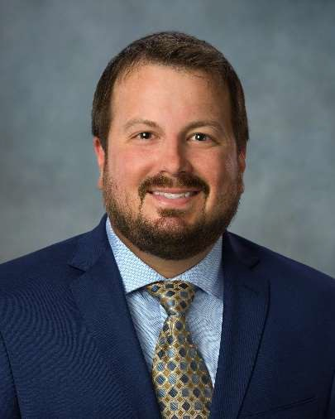
Your Wealth Management Team
As an integral part of the strong wealth management team in Jacksonville, Florida, Stephen Johnson serves as the Vice President, Trust Advisor, where he specializes in advising clients in all aspects of Estate Planning and Tax & Gift Planning, along with the prudent Fiduciary administration of many types of Trust vehicles. A native of Fayetteville, North Carolina, Stephen earned his bachelor’s degree with honors from Campbell University in Buies Creek, North Carolina, where he studied Trust & Wealth Management and Financial Planning.
After successfully completing an internship with US Trust, Bank of America in Kansas City, Missouri, Stephen began his career with the team as a Trust Relationship Officer in 2010, where he provided Estate Planning & Trust administration services to high net worth clients. After serving in that capacity for 4 years, Stephen moved to Merrill Lynch Trust Company as a Trust Officer II, where he partnered with Financial Advisors to provide Trust & Estate services to many private wealth clients.
In 2016, Stephen was presented with an opportunity to help establish the first wealth management office for Deutsche Bank Trust Company in Jacksonville, Florida. After building out a wealth management team and transitioning accounts from the New York office, he began establishing relationships with Estate Planning Attorneys and COI’s to grow the Deutsche Bank presence in Jacksonville. While successfully accomplishing these goals, Stephen also began pursuing the Certified Trust & Financial Advisor (CTFA) designation.
Stephen lives in Fernandina Beach, Florida with his wife Shelby and Puggle dog, Nova. In his spare time, Stephen enjoys fishing, surfing, golfing, and reading. Most importantly, he loves spending time with his family and friends in the Fernandina Beach area.
Stephen M. Johnson
Trust Advisor (904) 565-7975
stephen.johnson@regions.com
Internal Use

Slide 5
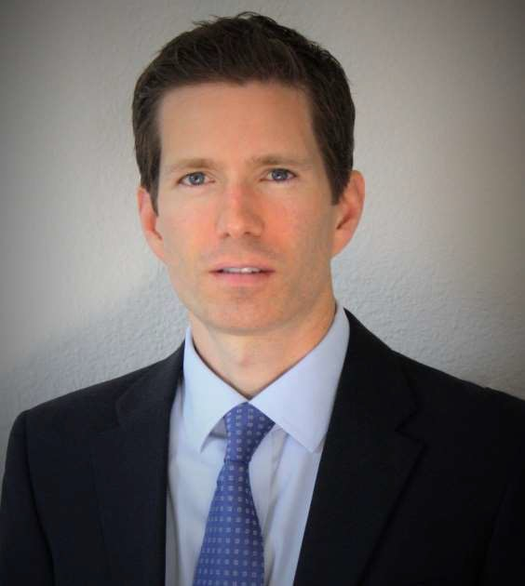
Your Wealth Management Team
Tim Foli is a Vice President and Portfolio Manager with Regions Private Wealth Management in Jacksonville, FL. In this role, he is responsible for creating and maintaining personalized investment solutions and a broad range of wealth management services including financial planning and wealth strategies. This includes assisting clients in navigating every market environment while providing traditional guidance in the areas of asset allocation, tax-minimization, retirement, and multi-generational strategies from risk-based planning strategies to banking and lending needs.
Tim was previously a Portfolio Manager with Northern Trust where he specialized in goals-based investment management and financial planning. Prior to joining Northern Trust, he spent 7 years with U.S. Trust, Bank of America Private Wealth Management where he tactically managed custom portfolios for high net worth individuals and families.
Tim earned his M.B.A. from Stetson University and B.S. degree in Finance from the University of South Florida. He is a CERTIFIED FINANCIAL PLANNER™ (CFP®) professional, Chartered Market Technician® (CMT), and is a member of the Chartered Market Technician’s Association (CMTA) in New York. He also holds the Chartered Retirement Plans Specialist (CRPS®) designation from the College for Financial Planning and a Certificate in Financial Planning from Florida State University.
In his spare time Tim enjoys spending time with his wife and two children and playing ice hockey and tennis.
Tim Foli, CFP®, CMT
Portfolio Manager (904) 565-7988
tim.foli@regions.com

Slide 6
Donor Advised Funds
  Donor transfers cash or other property to a fund held by a public host charity which makes distributions to other public charities as directed by the donor
Donors may make grants to any IRS qualified 501(c)(3) charity
No tax on the investment income generated in the account
Donors may name their successor donor advisor on the account
Deduction is 50% or 60% of adjusted gross income for donations of cash; deduction is 30% of adjusted gross income for donations of appreciated property
A full charitable gift tax deduction is available for lifetime gifts and a full charitable estate tax deduction is available for contributions to the fund at death

Slide 7
Private Foundations
Client opens and funds the (non-operating) private foundation - no donations are made from the general public
Established as a corporation or a trust
Has the ability to make grants to charities or to individuals
Private foundation must make qualifying distribution of at least 5% of the foundation's assets each year or pay a penalty tax
Private foundation is subject to IRS restrictions on investments, expenditures and dealings with its donors, directors, officers and any related persons
Income tax deduction for donations of cash is 30% of adjusted gross income
Deduction for donation of publicly traded long-term appreciated stock is 20% of adjusted gross income and based on fair market value of stock and deduction for donation of other long-term appreciated stock is 20% of adjusted gross income and based on basis of stock
Private foundations pay an excise tax equal to 1.39% of their net investment income - net investment income is interest, dividends, rents, royalties and income from similar sources, plus capital gain income, less deductions directly connected with the production and collection of the income

Slide 8
Charitable Remainder Trusts (CRTs)
Donor transfers property to the trust and trustee makes distributions to an individual beneficiary (the donor and/or other individuals) for life or a period not to exceed 20 years
  The payments are either a fixed annuity amount (CRAT) or an amount based on the fair market value of the property (CRUT) as revalued ever year
At the end of the term of payments to the individual(s), the remaining trust assets pass to charity(ies)
The remainder value distributed to the charity must equal at least 10% of the beginning value of the trust
Tax consequences of donation to CRT:
  Donor receives an income tax deduction for present value of charity's remainder interest
  Trust is tax-exempt and trust assets can be sold without income tax consequences (unless it has Unrelated Business Taxable Income)
  Annuity or unitrust payments to the individual beneficiary are subject to income tax on the individual beneficiary's income tax return, depending on the tax character of the income
    Income distributed can be ordinary income, capital gains, tax-exempt income or return of capital

Slide 9
CHARITABLE LEAD TRUSTS
Donor transfers assets to a trust where the charity is the initial beneficiary of the trust
Charity receives distributions for a designated time period – either a fixed amount (CLAT) or a percentage of the fair market value of the trust assets (CLUT)
No minimum or maximum distribution amount to charity is required
At the end of the designated time period, remaining trust assets are distributed to individual beneficiary(ies)
  Individual beneficiary could be donor and/or other individuals
CLT is not tax-exempt
  CLT can be a grantor trust for income tax purposes
    Donor can take income tax deduction for value of charity's lead interest but must pay income tax on income generated by trust without corresponding tax deductions in future years
    Deduction is 30% of adjusted gross income for cash and 20% of adjusted gross income for long-term gain property
  Non-grantor CLT can take a 100% deduction for gross income distributed to charity
    No income tax deduction available for the donor
    Trust must pay income tax at rates for non-grantor trusts

Slide 10
Qualified charitable DISTRIBUTIONS/rollovers From IRAs
Qualified charitable distributions/rollovers
IRA owners 70 ½ or older can distribute up to $100,000 from an IRA directly to charity without having distribution included in their gross income
Distribution counts towards the IRA owner’s required minimum distribution for the year of contribution
Under SECURE Act 2.0, amount eligible for a qualified charitable distribution will be indexed for inflation beginning in 2024
Qualified charitable distributions to charitable gift annuities and charitable remainder trusts under SECURE Act 2.0
  Starting in 2023, IRA owners can make a one-time qualified charitable distribution of up to $50,000 to a charitable gift annuity charitable remainder annuity trust or charitable remainder unitrust
  $50,000 limit will be indexed for inflation beginning in 2024

Slide 11
Qualified charitable DISTRIBUTIONS/rollovers From IRAs
Good candidates for Qualified Charitable Distributions (QCDs):
    Donors who do not itemize their deductions
    Donor who want to reduce their adjusted gross income
      To reduce or eliminate income subject to the 3.8% net investment income tax
      To reduce income tax on social security payments
      To reduce Medicare Part “B” premiums
  Donors who live in states with income tax on IRA distributions or donors who live in states with a state income tax with no charitable deduction
  Donors who do not rely on IRA distributions for lifestyle and other expenses
  Donors who do not want their individual heirs to inherit an IRA and pay ordinary income tax on the distributions
  Planning with $50,000 QCDs to charitable remainder trusts and charitable gift annuities - likely more effective for planning with charitable gift annuities versus charitable remainder trusts since charitable remainder trusts typically involve greater costs and administrative requirements to setup and maintain
tax.

Slide 12
SECURE Act 1.0 and changes to required minimum distributions for inherited iras
Law established new required minimum distribution rules for inherited IRAs:
Eligible Designated Beneficiaries (surviving spouse, minor child, disabled or chronically ill individual and individual not more than 10 years younger than IRA account owner) – distributions from IRA made over beneficiary’s life expectancy - the “stretch” IRA
All other designated beneficiaries – complete distribution of IRA account within 10 years of IRA account owner’s death
No designated beneficiary – distribution of IRA account within 5 years of IRA account owner’s death or over his or her actuarial life expectancy
IRA owner can name Charitable Remainder Trust as IRA beneficiary to replicate the lifetime “stretch” for designated beneficiaries other than Eligible Designated Beneficiaries
  CRT will not pay income tax upon receipt of IRA distributions, although the individual beneficiary will pay ordinary income tax on any IRA distributions from the trust
  Individual IRA owner’s estate also will receive an estate tax deduction for the charitable remainder interest
Not available for certain younger beneficiaries because of 10% exhaustion requirement for CRTs

Slide 13
SECURE ACT 2.0 and Trusts for Disabled or Chronically Ill Beneficiaries and Inherited IRAs
  Eligible Designated Beneficiaries include special needs discretionary trusts for disabled or chronically ill beneficiaries (not a see-through or conduit trust)
  Until recently, a special needs trust for a disabled or chronically ill beneficiary was eligible for the life expectancy stretch if all the current beneficiaries are disabled or chronically ill and the remainder beneficiaries are individuals
  New law allows an IRA owner to create a trust for a disabled or chronically ill beneficiary and name a qualified charity (a public charity other than a donor-advised fund) as a remainder beneficiary and still qualify for the life expectancy stretch for the individual beneficiary
  Suitable for IRA owners leaving IRA benefits to a trust for a disabled or chronically ill beneficiary who want a charity to receive remainder at the beneficiary’s death
  IRA owner has no other descendants and or has provided for them from other resources
  IRA owner wishes to “repay” charity who helped beneficiary
  Not suitable for IRA owners who want to name a donor advised fund or private non-operating family foundation as the remainder beneficiary

Slide 14
Planning Strategies WITH CHARITABLE LEAD TRUSTS
  Suitable for donors who want to reduce estate and gift taxes on highly appreciated assets while benefitting charity
    If the donor can get a low or discounted valuation on assets on the date of transfer and the assets grow substantially before they are sold in the future, more assets can pass to the heirs at a lower transfer tax cost
    Assets transferred to CLT are excluded from the donor’s estate for estate tax purposes
  CLT can be a S corporation shareholder
    Grantor trust CLT is eligible S corporation shareholder
    Electing Small Business Trust election for non-grantor CLT
    Estate tax planning with a family business - donor transfers interest in business to CLT
    Consider excess business holdings and unrelated business income rules
    Prohibition against excess business holdings applies to CLT only if value of charitable interest exceeds 60% of the value of the trust assets
    Income tax deduction for distributing unrelated business income to charity subject to charitable deduction percentage limitations for individuals
    Family members and/or entity can redeem the business interest from CLT for cash or a promissory note
    Grantor trust CLTs
Reversionary grantor CLT to mitigate taxes on liquidity event but trust assets included in donor’s estate
“Super” CLTs - excluded from donor’s estate and donor gets income and gift tax deduction for transfers
Non-grantor trust CLTs
  Suitable for donors to fund a donor advised fund or private foundation and/or do not itemize their deductions
  Distributions from CLT are not subject to charitable deduction percentage limitations for individuals
  If the income beneficiary of the CLT is a private foundation established by donor, donor should not participate in grantmaking decisions with respect to amounts received from the CLT
  Established at donor’s death
    Donor’s estate gets charitable estate tax deduction for value of charitable lead interest
    Step-up in basis for property passing to the trust
Zeroed out CLAT - present value of annuity payments are equal to or nearly equal to the value of the property transferred in the trust, resulting in no gift or estate tax consequences for the trust
May not be suitable in high interest rate environment
“Formula” zeroed-out testamentary CLAT
Notes:
1.) Note that CLTs can be set up for a tem of years or for the donor’s lifetime.

Slide 15
CHARITABLE PLANNING WITH REAL ESTATE
Transferring real estate to a Charitable Remainder Trust
Trustee can sell low-basis real estate and provide cash flow to the donor and/or other individuals without capital gains tax on the sale
Transfers of debt-financed real estate or interest in business entity that owns real estate (partnership or limited liability company) can result in Unrelated Business Taxable Income (UBTI)
  100% excise tax on UBTI for CRT
  Dividends, rents, royalties, interest payments, and gains or losses from the sale of a capital asset are not UBTI
Net income with or without makeup distributions Charitable Reminder Trust (NICRUT or NIMCRUT)
Requires annual payments to the individual beneficiary be the lesser of the fixed unitrust percentage or the net income earned by the trust
If the annual income earned by the trust is less than the specified percentage, the NIMCRUT trustee will pay out the difference in later years when the trust income exceeds the specified percentage
Suitable for donors who own real estate currently providing no income but that is expected to appreciate in value and produce income in the future and can forgo current cash flow
  Flip CRUT
  CRUT is NICRUT or NIMCRUT until triggering event occurs
  Upon occurrence of triggering event, trust converts to straight charitable remainder unitrust
  Sale of real estate cannot be in donor’s or Trustee’s control

Slide 16
CHARITABLE PLANNING WITH REAL ESTATE
Bargain sale to charity
  Sale of real estate to charity for less than fair market value
  Excess of fair market value over sale price qualifies for charitable income tax deduction
  Gain on sale is taxable income to donor
    Donor must apportion basis of the property between sale portion and the donated portion to determine gain
    Example - In year 1, D purchases real estate for $40,000. In year 10, D sells the real estate, which has a then fair market value of $100,000, to charity for $50,000. The charitable deduction on the bargain sale is $50,000 (the difference between the fair market value of $100,000 and the sale price of $50,000). The portion of the basis of the real estate allocated to the sale portion is $20,000 ([50,000 ÷ 100,000] × $40,000). D will have a long-term capital gain of $30,000 (the sale price of $50,000 less the allocated basis of $20,000).
    Another form of a bargain sale is when mortgaged real estate is transferred to charity by outright gift - the relief from indebtedness is considered gain realized by the donor (as if donor received cash for amount of debt relief)
    Suitable for donors who want to transfer real estate to charity, but wants cash in return
  Remainder interest in residence or farm
  Individual can retain life estate in personal residence (includes vacation home) or farm and gift remainder interest to charity
  Donor receives a current income tax charitable deduction equal to fair market value of remainder interest and residence or farm is removed from donor’s estate
  Suitable for donors who want to leave part of estate to charity without an immediate outlay of cash or other liquid assets they may otherwise need access to and/or whose heirs do not want to inherit real estate

Slide 17
CHARITABLE PLANNING FOR EXECUTIVES
Concentrated stock positions
  Transfer to Charitable Remainder Trust
    Trustee sells stock without incurring capital gains and donor receives income stream
    Only available for C corp stock – CRTs are not qualified shareholders of S corps
  Give to Donor Advised Fund
    Donor avoids capital gains tax on sale of appreciated stock and receives income tax deduction for fair market value of stock
    No retained benefit for the donor
    Give to Private Foundation
    Deduction for donation of publicly traded long-term appreciated stock is 20% of adjusted gross income and based on fair market value of stock and deduction for donation of other long-term appreciated stock is 20% of adjusted gross income and based on basis of stock
    Consider “excess business holdings” excise tax - typically, private foundation cannot own more than 20% of the voting stock, profits or capital interest in a corporation or partnership
      Excise tax of 10% imposed on a private foundation’s stock holdings in excess of 20%
      Permitted ownership is reduced by ownership interests of all disqualified persons
        Disqualified persons includes foundation managers, which includes trustees, directors, officers and other persons with similar authority, substantial contributors (whether individuals or entities) to the foundation, family members of such persons, and entities controlled by such persons
    If private foundation holds less than 2% of the ownership interests of a business enterprise, the holdings of all disqualified persons are ignored
.

Slide 18
CHARITABLE PLANNING FOR EXECUTIVES
Stock options
  Right of employee to purchase stock at a fixed price - price is usually the fair market value of stock at time option is granted
  Does stock option plan even permit transfer of the option?
  Incentive Stock Options (ISOs)
    No income tax on grant or exercise but difference between the fair market value of stock at exercise and option price included in employee’s alternative minimum tax calculation
    Employee does not recognize income until he or she sells stock received upon exercise
    Employee cannot directly donate ISOs to charity during life but may exercise ISOs and donate actual shares
      Plan may allow ISO to be exercised by employee’s estate – if so, bequeathing an ISO to charity will provide charitable estate tax deduction
      Nonqualified Stock Options (NSOs)
Subject to income tax upon grant if option has readily ascertainable value or when NSO is exercised
Employee pays ordinary income tax on difference between exercise price and stock’s current fair market value
If NSO is donated to charity, employee will pay ordinary income tax when charity exercises NSO
If employee instead donates shares received from exercising NSO, donor will have charitable income tax deduction that can offset income from exercise
If NSO can be transferred at death:
  Charity does not pay income tax upon exercise
  Charitable estate tax deduction for value of NSO donated

Slide 19
DISCLAIMERS
The opinions expressed in the presentation are statements of the speaker’s opinion, are intended only for informational purposes, and are not formal opinions of, nor binding on Regions Bank, its parent company, Regions Financial Corporation and their subsidiaries, and any representation to the contrary is expressly disclaimed.

